Slide 1
Model Optimisation
Methods Used to Optimise the K-Means Algorithm Model:
Dropped the “categories” column
Filtered the “published year”
Binned the “published year”
Dropped the “authors” column
Eliminating outliers

Slide 2
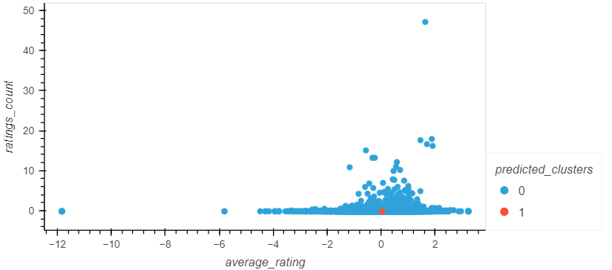
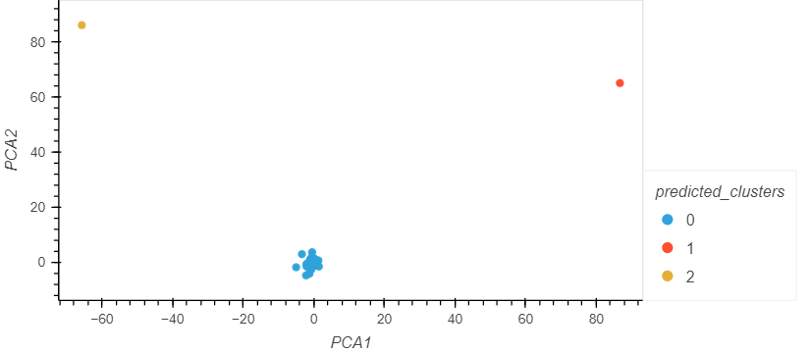
Model Optimisation: Dropping the authors column
Elbow/Silhouette Method:
The silhouette method suggests the optimum k-value is 2
Running a K-means model with 2 clusters resuts in a Calinski-Harabasz Index score of 20.89.
PCA:
The optimum k-value is 3.
Running the K-means algorithm increases the Calinski-Harabasz Index to 177156.05
Result seems highly determined by 2 outlier books.

Slide 3
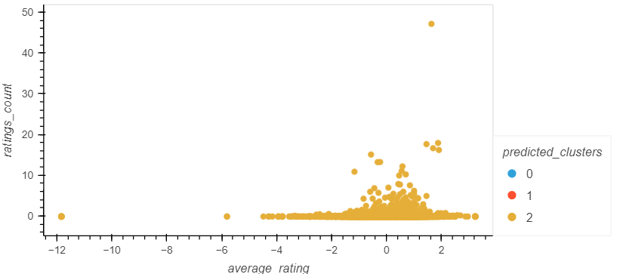
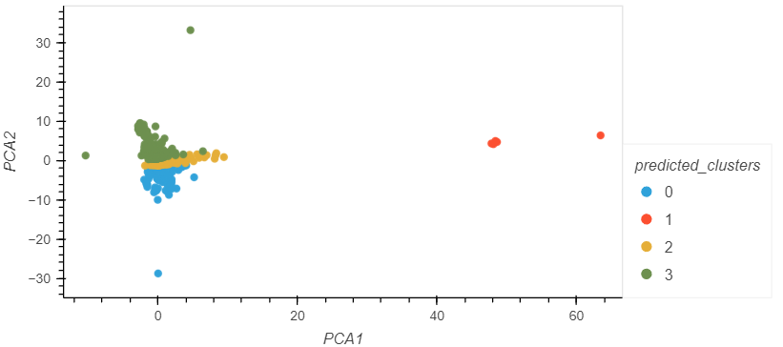
Model Optimisation: Dropping the categories column
Elbow/Silhouette Method:
The silhouette method suggests 3 as the best value for k.
Running a K-means model with 3 clusters resuts in a Calinski-Harabasz Index score of 1.95.
PCA:
The optimum value for k is 4
Running the K-means algorithm increased the Calinski-Harabasz Index to 5600.92.

Slide 4
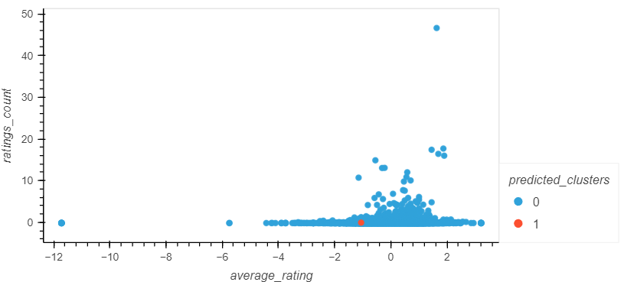
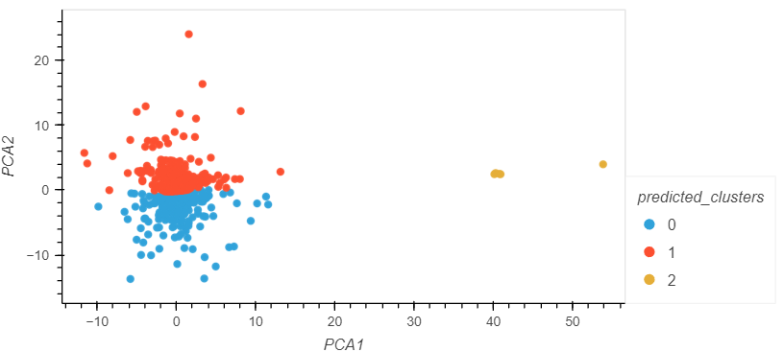
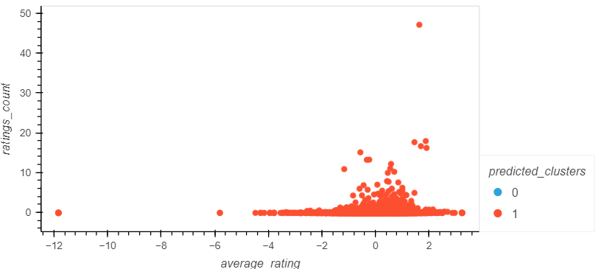
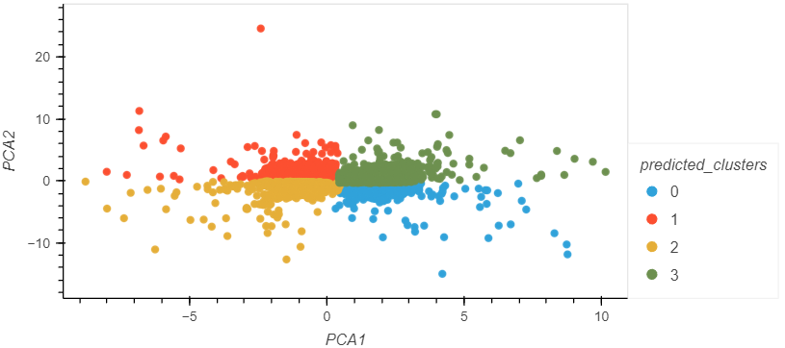
Model Optimisation: Filtering and Binning published year
Elbow/Silhouette Method:
Running a K-means model resulted in a Calinski-Harabasz Index score of 2.95 and 2.35 for the filtered and binned models respectively.
PCA:
Running the K-means algorithm on filtered and binned data resulted in a Calinski-Harabasz Index score of 4010.15 (k=3), and the binned data in a score of 4031.18 (k=4).

Slide 5
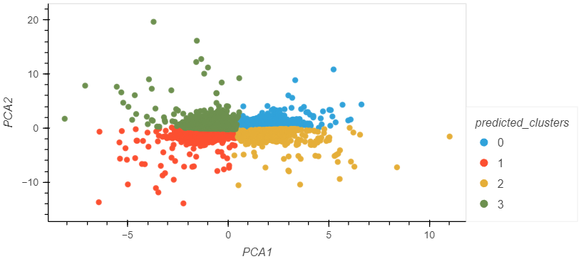
Model Optimisation: Eliminating Outliers
Running the k means algorithm on the pca model gives a Calinski-Harabasz Index of 6247.65
Results not biased by outlier books and clusters are more accurate

